Slide 1

Subtleties about [Pre-]Training Data: Imbalance and Staleness
Daniel Khashabi
Notes:
Thank you for having me! It's an honor to be here!

Slide 2





The success we dreamed of
Language models that are remarkably capable at solving many important NLP benchmarks.
Notes:
Of course, to this audience, this is not news.
We are at a point where we dreamed of years ago.
Language models that are remarkably capable at many important NLP task.

Slide 3
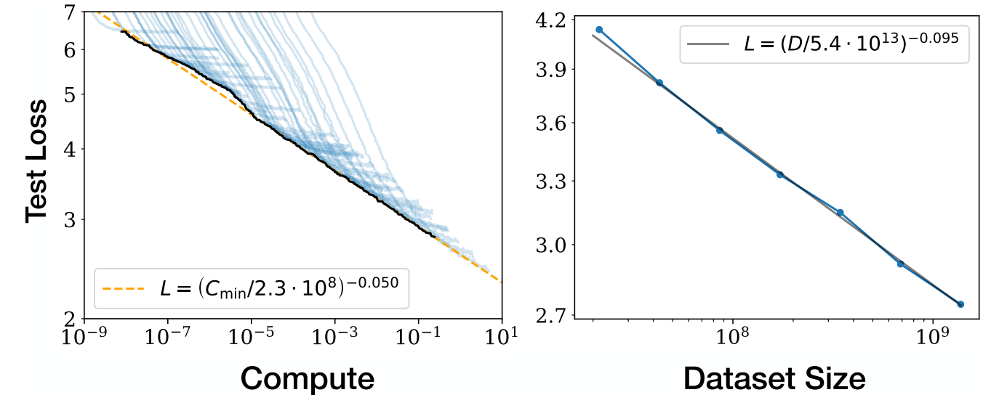
AI Data is the “new electricity”
Kaplan et al. 2020; among others
More data (and compute) leads to better models.

Slide 4
Limits of scaling “laws”
Kaplan et al. 2020; among others
Which data? How is it distributed?

Slide 5
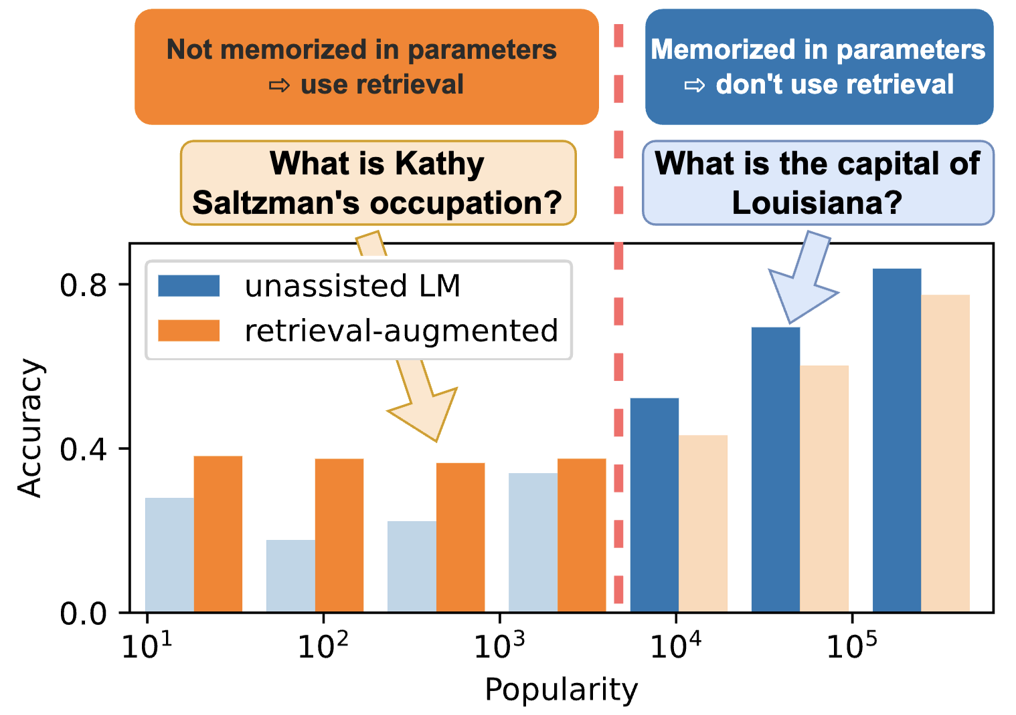
Our understanding of data remains limited
Not all knowledge is uniformly distributed.
Factual accuracy of LLMs is positively correlated with ”popularity” of the inputs.
(Mallen et al. 2023; among others)

Slide 6

Our understanding of data remains limited
The recent progress (e.g., Llama2 to Llama3) seems to be mostly due to better data engineering (better data filtering).
There are various nuances about data that are not explained any ”laws” and remain poorly understood.

Slide 7

Today
Stale data
A ton world data is old. How does that impact our models?
Imbalanced data
Most data follow a long-tail distribution. How should we deal with it?
Notes:
Where we, I think, is that:
…
Specifically, today I am going to discuss two topics on reliability of models.

Slide 8
Today
Stale data
A ton world data is old. How does that impact our models?
Imbalanced data
Most data follow a long-tail distribution. How should we deal with it?
Notes:
Where we, I think, is that:
…
Specifically, today I am going to discuss two topics on reliability of models.

Slide 9

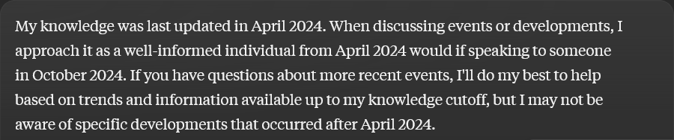
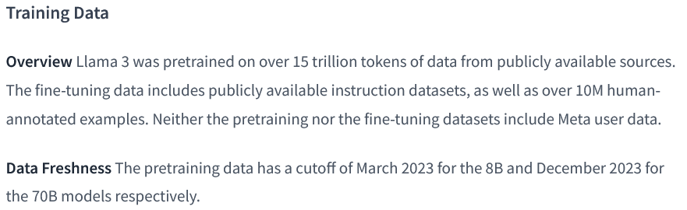
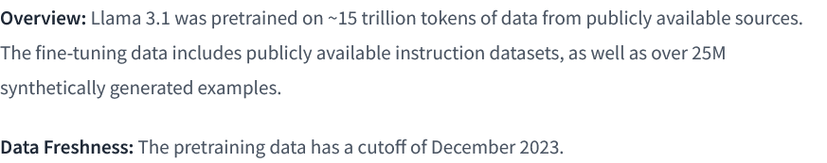
Knowledge Cutoffs
Notes:
If you've experimented with LLM, you've likely encountered descriptions similar to those presented here.
For competitive reasons, many LLM providers choose to keep their pre-training datasets confidential, opting instead to disclose a single knowledge cut-off date.

Slide 10
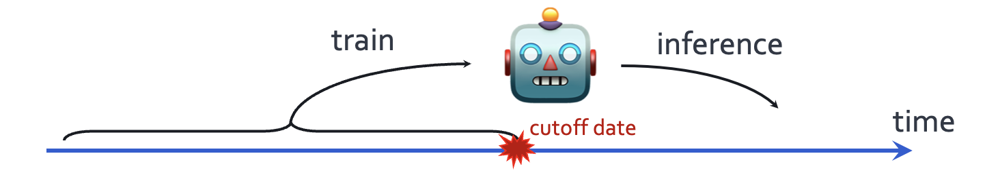
Temporal misalignment: LLMs stale over time
Known: Their quality degrade after their cut off date.
Are LLMs’ knowledge before cutoff date consistently good?
Luu et al. Time Waits for No One! Analysis and Challenges of Temporal Misalignment., NAACL 2022
Lazaridou et al. Mind the Gap: Assessing Temporal Generalization in Neural Language Models, NeurIPS 2021
Notes:
The first issues that I will discuss is about time.
When designing a language model, we train it on past data that is available on the web before a fixed cut off date, but we evaluate it on the examples of future.
Now it is well-understood that their performance degrades, the longer we move post the cut off date.
What about its quality before the cut off date?
Is their knowledge before the cutoff date consistently good?

Slide 11



Dated Data: Tracing Knowledge Cutoffs in Large Language Models
Jeffrey Cheng, Marc Marone, Orion Weller,
Dawn Lawrie, Daniel Khashabi, Benjamin Van Durme
🥇 COLM 2024 Outstanding paper award! 🥇
https://arxiv.org/abs/2403.12958

Slide 12
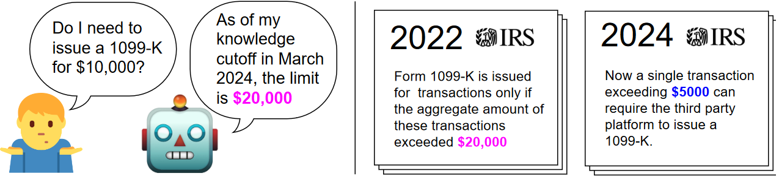
Knowledge before the [claimed] cutoff date
Do all resources in the training data share the same reported knowledge cutoff?
Notes:
- Specifically the motivating question is … .for example, if a model is trained on various resources like Wikipedia or PubMed, do all these resources share the same reported cut-off date?
This important for users who need up-to-date information from their models. Imagine an LLM user querying a model about tax documents. Even if the model's reported cut-off is 2024, if its knowledge of those tax documents is aligned with an earlier date, say 2022, the user might receive incorrect information.

Slide 13
Knowledge before the [claimed] cutoff date
Do all resources in the training data share the same reported knowledge cutoff?
The effective cutoff of an LLM (with respect to a resource) is the date that matches the LLM’s best knowledge of that resource.
Notes:
To study this question, we define the concept of an "effective cut-off" for an LLM ….

Slide 14
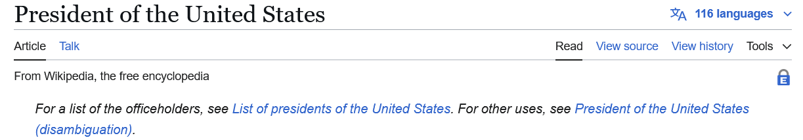
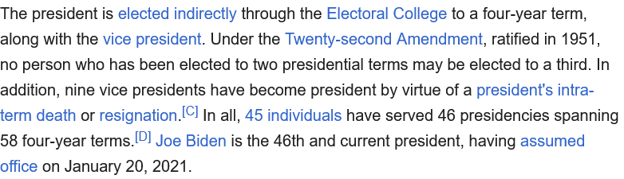
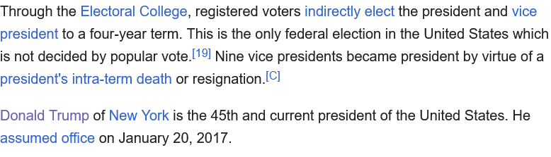
Effective cutoff == reported cutoffs?
It’s possible that they’re not the same.
Claimed cutoff shows the latest version of data.
Effective cutoff depends on how much old/stale information are there.
Notes:
With this definition, we pose the central question: Are effective and reported cut-offs in LLMs the same?
We hypothesize that …. because reported cut-offs typically refer only to the most recent version of a resource seen during training, potentially overlooking other versions.
For example, if a model is trained on a specific Wikipedia dump from October 2024, a naïve view is to think that the model should remember all the information from the latest version of Wikipedia.
However, other versions of the same Wikipedia documents might be present in the model's training data which would skew model’s knowledge.

Slide 15

How do we measure knowledge over time?
WIKISPAN:
Collect 5000 most edited topics
Scrape monthly versions from April 2016 to April 2023
We also built NEWSPAN based on New York Times articles. Feel free to checkout the details in the paper.
Notes:
To investigate this, we estimate effective cut-offs by creating time-spanning datasets and measuring perplexity across the data, identifying effective cut-offs from these measurements. Importantly, our method for estimating effective cut-offs does not require access to the model's pre-trained data, although we later verify our results using ground truth data.
We constructed a dataset from Wikipedia, we collected the 5,000 most edited topics by edit number and scraped versions of these documents monthly from April 2016 to April 2023. This resulted in a total of 5,000 topics over 84 months, forming the WikiSpan dataset. A document in WikiSpan is simply a version of a Wikipedia topic at a specific time.
I’ll also note that …

Slide 16
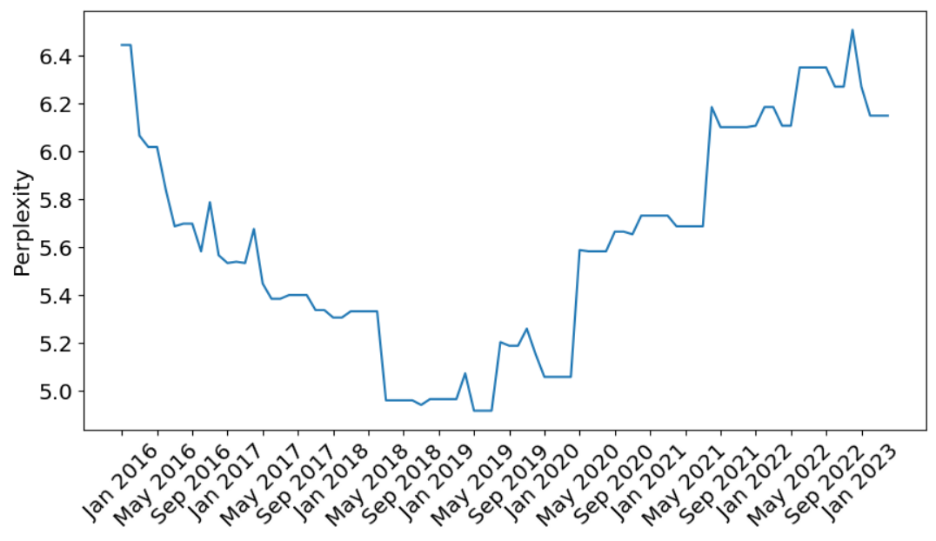
Extracting PPL over time with WIKISPAN
WIKISPAN documents: version of Wikipedia topic t at time m
Measure perplexity of first 512 tokens of each document, across all topics and months
Perplexity of the Wikipedia document “Liverpool'' under Pythia-7b. Each point is the perplexity of the document at that time.
Notes:
A document in WikiSpan is simply a version of a Wikipedia topic T at time M.
For each topic, we measured the perplexity of the first 512 tokens across all months, allowing us to generate perplexity curves.
For example, the perplexity of the Wikipedia topic "Liverpool" under the Pythia model is shown here, with each point representing the perplexity of a document at a specific date.

Slide 17
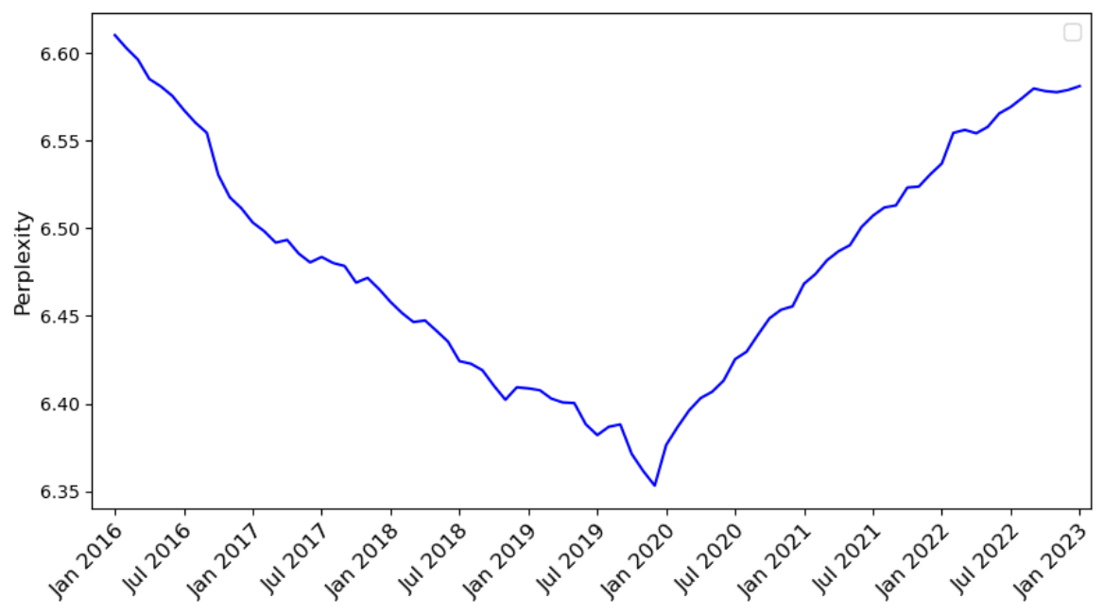
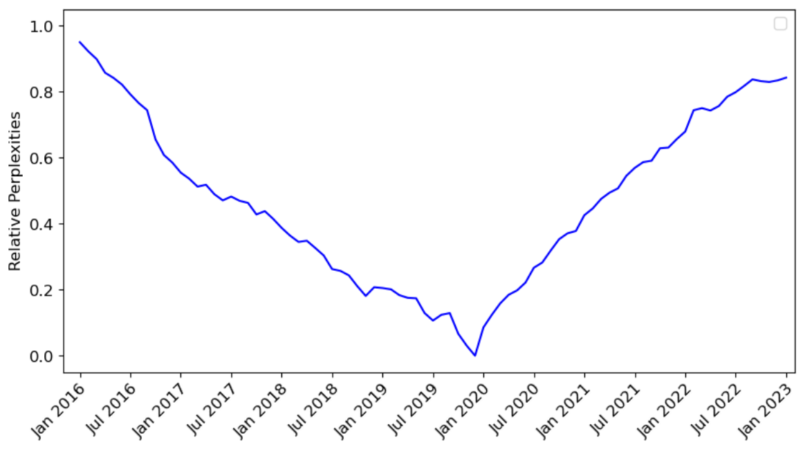
Extracting PPL over time with WIKISPAN
Normalization
Aggregate perplexities with 95% truncated mean within each month
Perform 0-1 normalization over entire time-span
Effective knowledge cutoffs are the argmin of relative perplexity curves
Perplexity measurements of documents
Aggregate along month axis with truncated mean
Convert to relative perplexities by 0-1 scaling
Notes:
We aggregate these perplexity curves across topics to obtain a single curve for each model.
During this averaging we use 95% truncated mean to remove outliers as some documents temporarily became stub articles before reverting.
After obtaining complexity curves for each model, we perform 0-1 normalization across the entire time span to convert perplexities into relative perplexities. This normalization allows us to compare results across different model families, as perplexities are usually not comparable due to differences in model architecture and pre-training data.
Now given these perplexity trends for each models, let’s see how their cutoffs look like.
Finally, we identify the effective cut-offs of these models as the argument of the relative perplexity curves, indicated by the red line.

Slide 18
C4-derived models on WIKISPAN
RedPajamas (Together Computer)
“We use the Wikipedia dataset available on Huggingface, which is based on the Wikipedia dump from 2023-03-20 and contains text in 20 different languages. The dataset comes in preprocessed format, so that hyperlinks, comments and other formatting boilerplate has been removed.”
Notes:
Now, for some results: We first consider models trained on C4. The first model is RedPajamas, which uses w Wikipedia dump from March 2023 dump, which we take as the reported cut-off date.

Slide 19
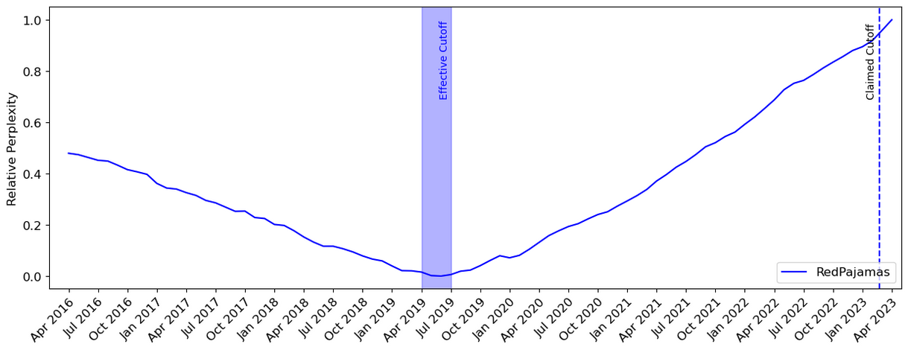
C4-derived models on WIKISPAN
claimed cutoff
Notes:
Here is the results: …
Our results show that whilethe effective cut-off is much earlier than the claimed cut-off dated, around mid-2019.

Slide 20
C4-derived models on WIKISPAN
LLaMA (Meta)
“We add Wikipedia dumps from the June-August 2022 period, covering 20 languages, which use either the Latin or Cyrillic scripts: bg, ca, cs, da, de, en, es, fr, hr, hu, it, nl, pl, pt, ro, ru, sl, sr, sv, uk. We process the data to remove hyperlinks, comments and other formatting boilerplate.”
Notes:
Next, we examine LLaMA, which uses a Wikipedia dump from June 2022,.

Slide 21
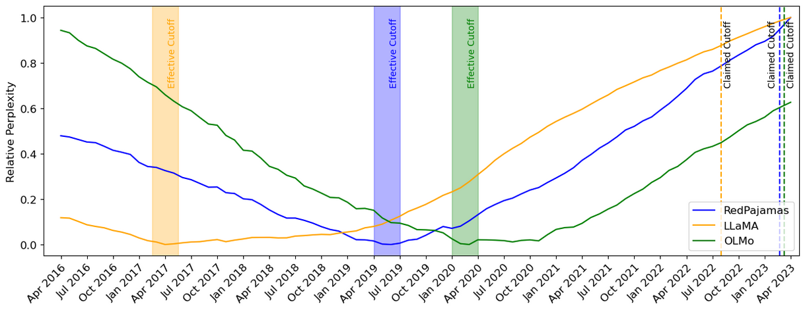
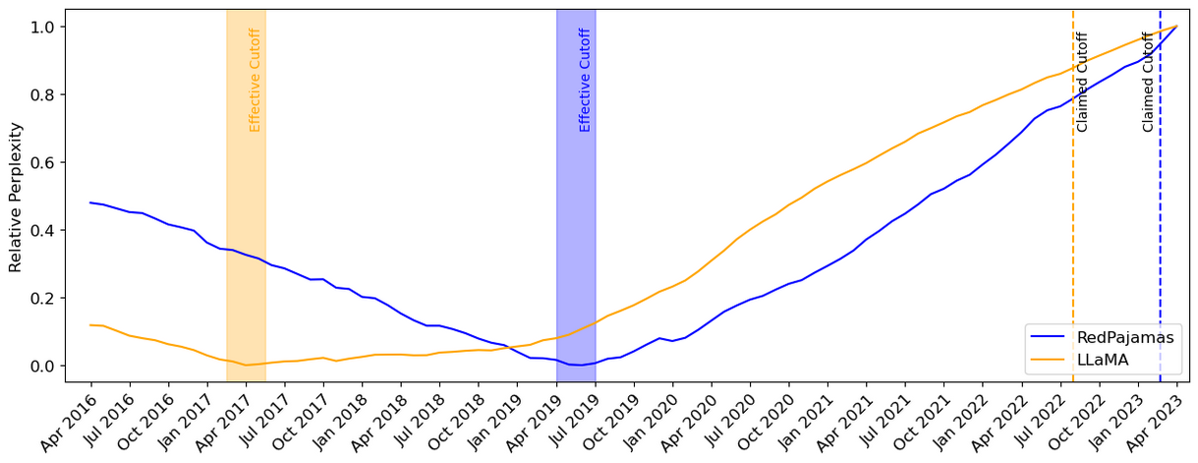
C4-derived models on WIKISPAN
Notes:
and find a significant 5-year gap between the effective and reported cut-offs.

Slide 22
C4-derived models on WIKISPAN
OLMo (AI2)
“Dumps were downloaded from Wikimedia’s website. We use the dump from March 20th, 2023.”
Notes:
using a March 2023 Wikipedia dump

Slide 23
C4-derived models on WIKISPAN
Effective cutoff date can be much earlier than the claimed cutoff date.
Notes:
we observe a discrepancy between effective and reported cut-offs.

Slide 24
Pile-derived models on WIKISPAN
Pile (EleutherAI)
“We use the wikipedia/2020301.en dataset from TensorFlow Datasets. We prepend the title to the body of each article, separated by two newlines.”
Notes:
We also repeated these experiments for Models trained exclusively on the Pile, which uses a March 2020 Wikipedia dump.

Slide 25
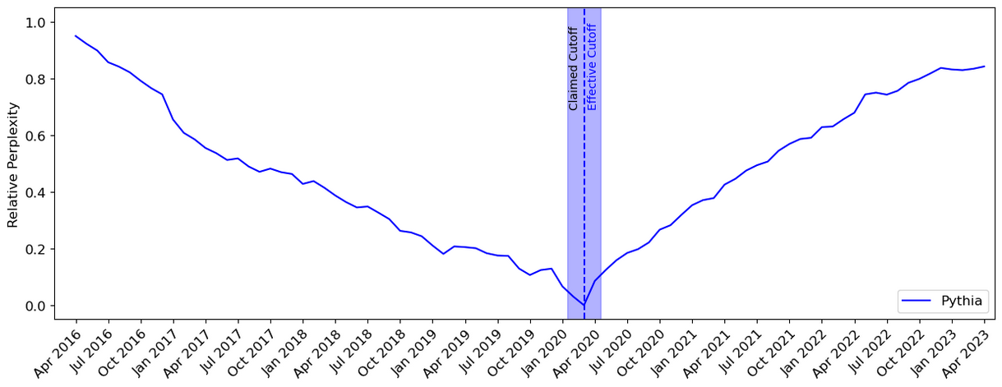
Pile-derived models on WIKISPAN
Notes:
On these models, to our surprise, we observed agreement between effective and reported cut-offs.
For instance, Pythia, trained exclusively on the Pile, aligns its effective and reported cut-offs.

Slide 26
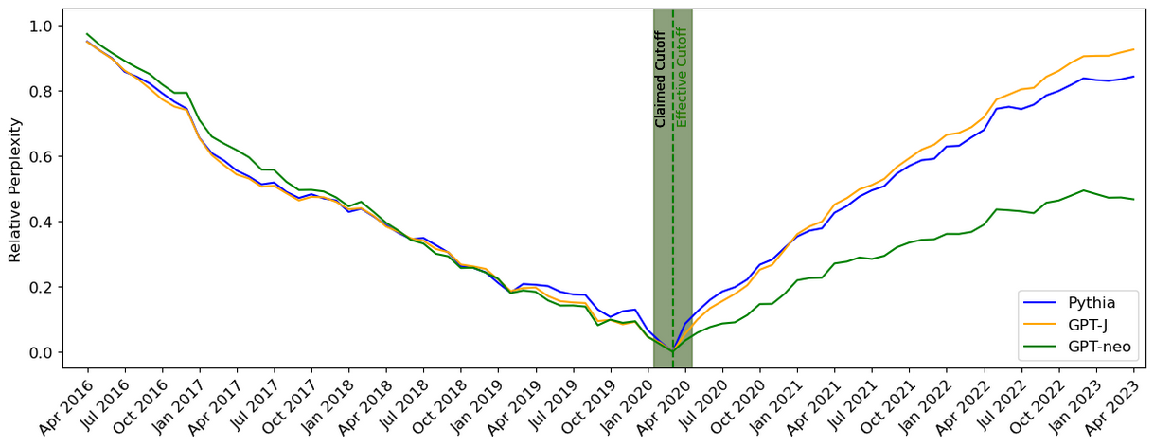
Pile-derived models on WIKISPAN
Effective cutoff and the claimed cutoff date can be the same!
Notes:
The same holds for other models trained exclusively on the pile namely gptj and GPT-Neo also show the same agement between their effective and reported cut offs.

Slide 27
Why do there exist discrepancies between effective and reported cutoffs?
Notes:
…
To answer this, we conducted a thorough investigation into available pre-training datasets, indexing over 4 trillion tokens.

Slide 28
Factors contributing to the misalignment between effective and reported cutoff:
Prevalence of stale data
Complications in deduplication pipelines
Notes:
Our analysis reveals two major reasons for these inconsistencies:

Slide 29
Factors contributing to the misalignment between effective and reported cutoff:
Prevalence of stale data
Complications in deduplication pipelines

Slide 30
Pre-training data contain lots of old/stale data
The distribution of older/stale data in C4 which is popularly used as part of pre-training.
(lower is better)
claimed cutoff
Cheng et al. Dated Data: Tracing Knowledge Cutoffs in Large Language Models.., arXiv 2024
Notes:
Non-trivial amount of old/stale data inside pre-training data.
Depending on which pre-training corpus you look at, you may see more older than data than newer ones.
Why is this happening?
Part of the issue is that, dealing with pre-training data is challenging. It’s hard to balance for older and newer data.
Part of the issue is the urge to scale. We need more data to scale. It’s better to have more data, then less data

Slide 31
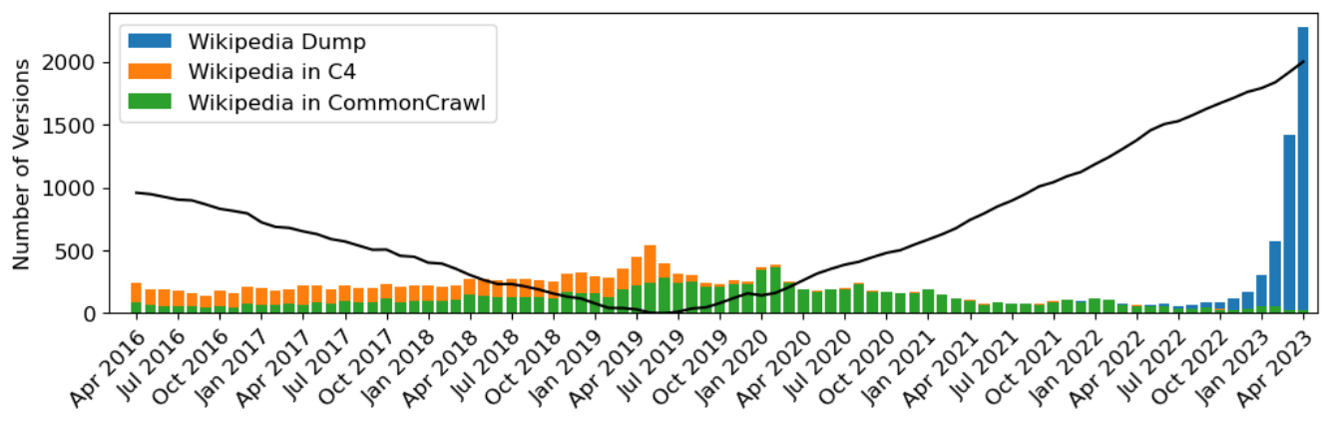
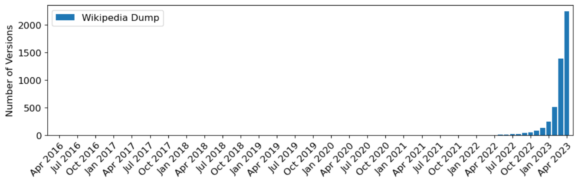
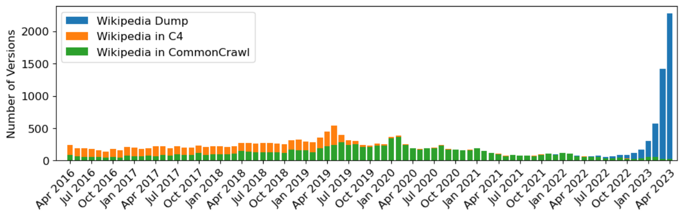
Prevalence of stale data
RedPajamas is trained on: C4, CommonCrawl dumps and Wikipedia
Breakdown of RedPajamas training corpus:
CommonCrawl dumps contain old data that bias effective cutoffs.
Notes:
Many LLMs are trained using Common Crawl dumps, and our analysis reveals that a significant portion of the data in each dump is outdated.
When multiple Common Crawl dumps are combined, as is often done in training modern LLMs, the resulting dataset is heavily skewed towards older dates.
Here I am showing the breakdown of old versions of Wikipedia in RedPejamas.
Note that RedPajamas was based on C4 CommonCrawl dumps and the direct Wikipedia dump from March 2023.
Here in blue you see the Wikipedias in RedPajamas training corpus correspond to the March 2023 dump. However, these versions make up less than 20% of all the versions present in the entire training corpus.
Over 80% of the Wikipedia versions are older ones included from C4 and CommonCrawl.
This distribution aligns with the relative perplexity curve we calculated for RedPajamas.
Our first key takeaway is that Common Crawl dumps contain outdated data, which biases the effective cutoff of these language models.

Slide 32
Factors contributing to the misalignment between effective and reported cutoff:
Prevalence of stale data
Complications in deduplication pipelines

Slide 33
Deduplication Issues
It is common practice to deduplicate pre-training datasets
Fuzzy deduplication should remove different versions of Wikipedia documents
Exact deduplication should remove exact copies of Wikipedia document
We empirically find many duplicates in pretraining datasets!
By the end of the 17th century, the Chinese economy had recovered from the devastation caused by the wars in which the Ming dynasty were overthrown, and the resulting breakdown of order.[147] In the following century, markets continued to expand as in the late Ming period, but with more trade between regions, a greater dependence on overseas markets and a greatly increased population.[148][149] The government broadened land ownership by returning land that had been sold to large landowners in the late Ming period by families unable to pay the land tax.[150] To give people more incentives to participate in the market, they reduced the tax burden in comparison with the late Ming, and replaced the corvée system with a head tax used to hire laborers.[151] The administration of the Grand Canal was made more efficient, and transport opened to private merchants.[152] A system of monitoring grain prices eliminated severe shortages, and enabled the price of rice to rise slowly and smoothly through the 18th century.[153] Wary of the power of wealthy merchants, Qing rulers limited their trading licenses and usually refused them permission to open new mines, except in poor areas ...
By the end of the 17th century, the Chinese economy had recovered from the devastation caused by the wars in which the Ming dynasty were overthrown, and the resulting breakdown of order.[148] In the following century, markets continued to expand as in the late Ming period, but with more trade between regions, a greater dependence on overseas markets and a greatly increased population.[149][150] The government broadened land ownership by returning land that had been sold to large landowners in the late Ming period by families unable to pay the land tax.[151] To give people more incentives to participate in the market, they reduced the tax burden in comparison with the late Ming, and replaced the corvée system with a head tax used to hire laborers.[152] The administration of the Grand Canal was made more efficient, and transport opened to private merchants.[153] A system of monitoring grain prices eliminated severe shortages, and enabled the price of rice to rise slowly and smoothly through the 18th century.[154] Wary of the power of wealthy merchants, Qing rulers limited their trading licenses and usually refused them permission to open new mines, except in poor areas ...
Notes:
Our second reason between the discrepancies between effective and reported cutoffs are complications and duplication pipelines.
It is a common practice to deduplicate pre-training data sets and we would expect methods uh and fuzzy deduplication methods such as Minhash and exacty duplication methods such as Bloom filters to remove old versions of documents.
Old data wouldn't be so much of an issue if the duplication pipelines were able to detect and filter out these old versions.
However these deduplications are brittle and fail to detect semantically similar versions of documents.

Slide 34
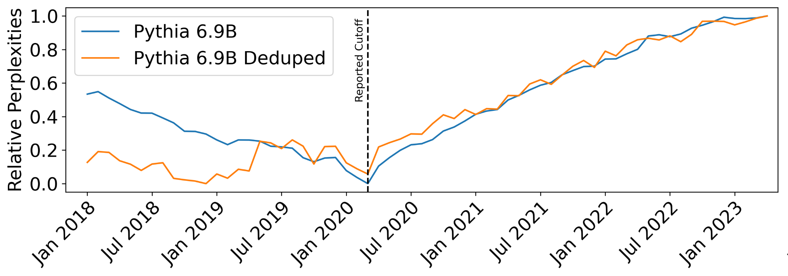
Deduplication Issues
The Pile purposely upsamples Wikipedia documents at reported cutoff
Duplicate documents bias effective cutoff towards their version date.
Notes:
To see the effect of these duplicate documents we first recall that models train on the pile saw an agreement between their effective and reported cutoffs.
And this agreement was in large part due to the fact that the pile purposely upsamples versions of its Wikipedia documents in its uh included dump.
if we remove these all purposely upsample documents through further duplication and then train a language model on the duplicated pile we would get these results:
in blue is the pythia uh model trained on the entire pile with this purpose the upsample versions and we see an agreement between the effective cutof uh in mid 2020 with the reported cut off.
However when we train a language model on the deduplicate pile that removed these upsampled versions we see the effective cut off is now much earlier uh in late 2018. and we see now the discrepancy between effective and reporter cut offs.
This brings us to a second takeaway which is duplicate documents will bias the effective cuto off towards the version date.

Slide 35
Summary thus far
There do exist discrepancies between effective and reported knowledge cutoffs in modern LLMs
Effective cutoffs of modern LLMs are years earlier than reported cutoff
CommonCrawl dumps include older versions of resources
Old versions and their duplicates are not removed by deduplication pipelines
Open problem: how should we strike a balance between data coverage and recency?

Slide 36
Pretraining datasets
The Pile
Open access curated dataset with 22 sub-datasets (arXiv, Wikipedia, etc.)
Contains 22 random chunks from the 3679 extracted from 7 years of CommonCrawl Dumps (2013 – 2020)
Contains Wikipedia dump from March 2020
C4
A single heavily processed CommonCrawl Dump from April 2019

Slide 37
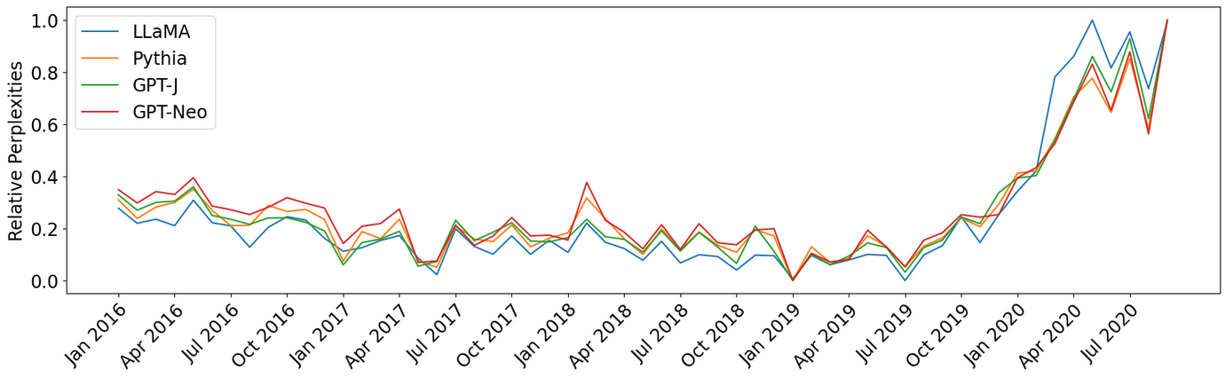
NYTimes

Slide 38
Today
Stale data
A ton world data is old. How does that impact our models?
Imbalanced data
Most data follow a long-tail distribution. How should we deal with it?
Notes:
Where we, I think, is that:
…
Specifically, today I am going to discuss two topics on reliability of models.

Slide 39
Today
Stale data
A ton world data is old. How does that impact our models?
Imbalanced data
Most data follow a long-tail distribution. How should we deal with it?
Notes:
Where we, I think, is that:
…
Specifically, today I am going to discuss two topics on reliability of models.

Slide 40
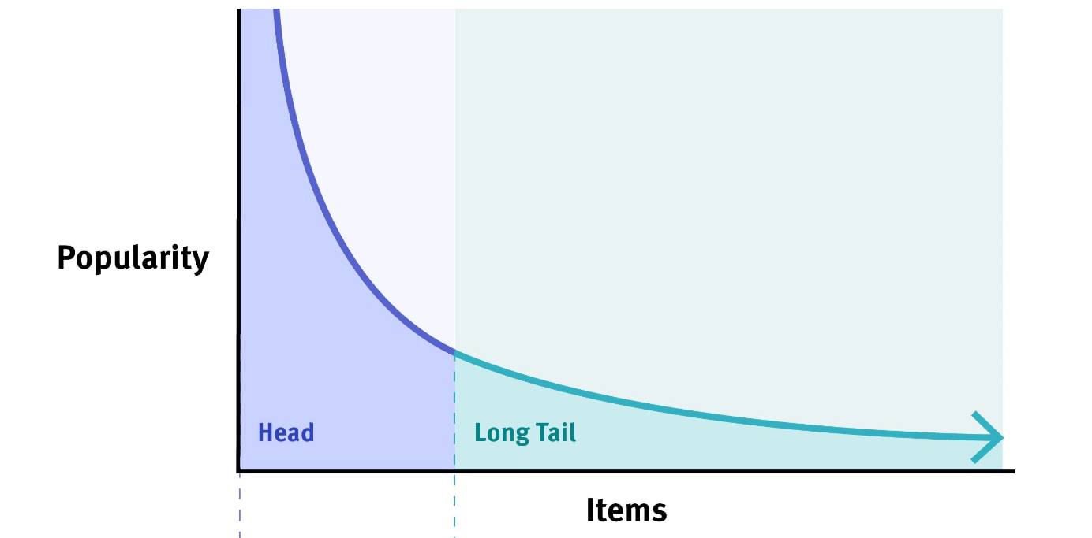
Long-tail of problems: There are many infrequent concepts/problems
Notes:
...
- There are many things (concepts, languages, ideas) that are infrequent in the world and in the pretraining data of LLMs.
Let's see a concrete example of this.

Slide 41
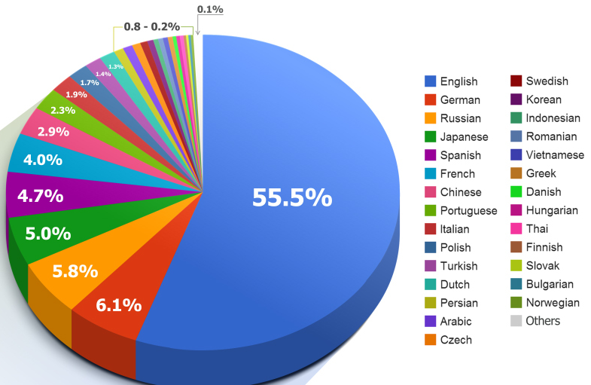
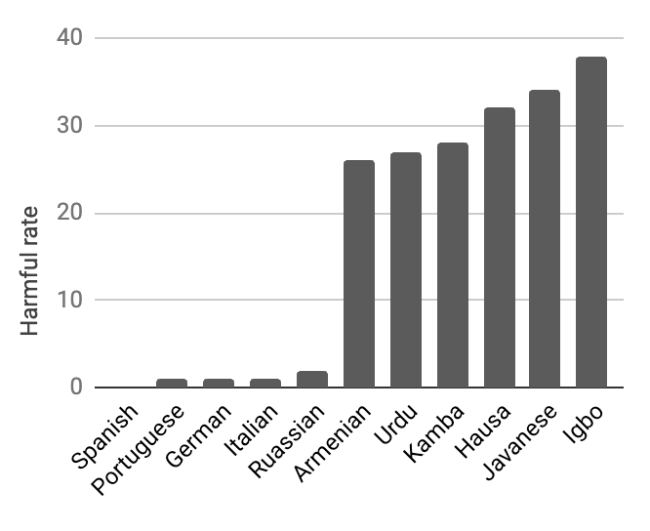
The long tail of languages
high-resource
(head)
low-resource
(tail)
https://commons.wikimedia.org/wiki/File:2014_Distribution_of_Languages_on_Internet_Websites.jpg
Shen et al. The Language Barrier: Dissecting Safety Challenges of LLMs in Multilingual Context., ACL 2024

Slide 42
The long tail of languages
What is the effective way to train models on such imbalanced data?
high-resource
(head)
low-resource
(tail)
Shen et al. The Language Barrier: Dissecting Safety Challenges of LLMs in Multilingual Context., ACL 2024

Slide 43

Upsample or Upweight? Balanced Training on Heavily Imbalanced Datasets
Tianjian Li, Haoran Xu, Weiting Tan,
Kenton Murray and Daniel Khashabi.
https://arxiv.org/abs/2410.04579
(under review)

Slide 44
Training on a collection of “domains”
Consider training a model on a collection domains:
Loss, treating all domains uniformly:
…
Notes:
Let’s make the setup more formal.
Let’s say we want to train a model on a set of K domains: D_1, D_2, ….
As I am showing here visually, these domains might come in different sizes (not necessarily sorted, as I am showing here).
A native way of training model on this data is to train a model on the union of all this data (or a uniform sample from it).
Naive aggregation often results in imbalanced performance across domains when high-resource domains dominate the aggregated loss.

Slide 45
Scalarization (S)
Define a per-domain weights (scalars) to adjust their weights:
…
Assigned a higher weight to the smaller/harder domains
Notes:
One fix this to this issue is “Scalarization” which assigning weights to each domain and perhaps setting a larger weight to the smallest domain.
Formally, define a set of per-domain weights (scalars) that we will use to adjust the weight of each domain.
Now I can rewrite my loss function as the the weighted sum of individual losses
Scalarization balances the loss by assigning a higher weight to harder or low-resource domains.

Slide 46
Temperature Sampling (TS)
Define a probability distribution for sampling instances:
…
Notes:
Another alternative is Temperature Sampling.
Instead of assigning weights to losses, we can also sample more frequently from the low-resource domain to achieve balanced training.
Formally, define a probability distribution for sampling from our data domains based on their sizes.
And then define a loss that that involves sampling domains according to our probability distribution and then sampling from the selected domain.

Slide 47
Temperature Sampling vs. Scalarization
…
Notes:
Let me bring it back together.
- ….

Slide 48
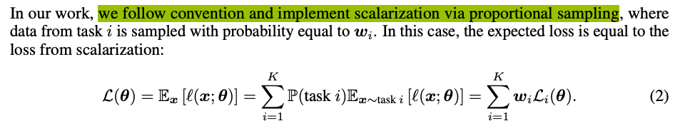
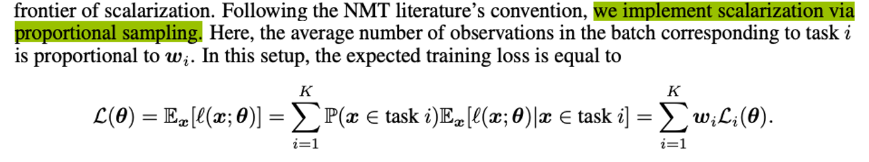
Is Temperature Sampling == Scalarization?
The common understanding is that these two are equivalent.
Spoiler: they’re not the same!
Choi et al. Order Matters in the Presence of Dataset Imbalance for Multilingual Learning, NeurIPS 2023
Xin et al. Do Current Multi-Task Optimization Methods in Deep Learning Even Help?, NeurIPS 2022
Xie et al. (NeurIPS, 2023) and Fan et al. (ICML, 2024) implement TS via S.
Notes:
The common understanding is that Temperature Sampling is equivalent to Scalarization.
Here are two screenshots that I have selected from two papers that seem to use them interchangeably.
We will then show that they are \underline{not} equivalent.

Slide 49
TS-loss = S-loss
Theorem: For any sampling temperature , there exists a set of weights for which S-loss is equivalent to TS-loss (on the whole data).

Slide 50
TS = S, under *full* gradient descent
Theorem: For any sampling temperature , there exists a set of weights for which S-loss is equivalent to TS-loss (on the whole data).

Slide 51
TS == S, under *full* gradient descent
Corollary: gradients estimation based on S-loss and TS-loss are both unbiased estimates (of gradient on full dataset).

Slide 52
TS gradients have lower variance than S
Theorem: Gradient estimates of S-loss have higher variance than those by TS-loss:
Theorem: The variance gap increases monotonically for .

Slide 53
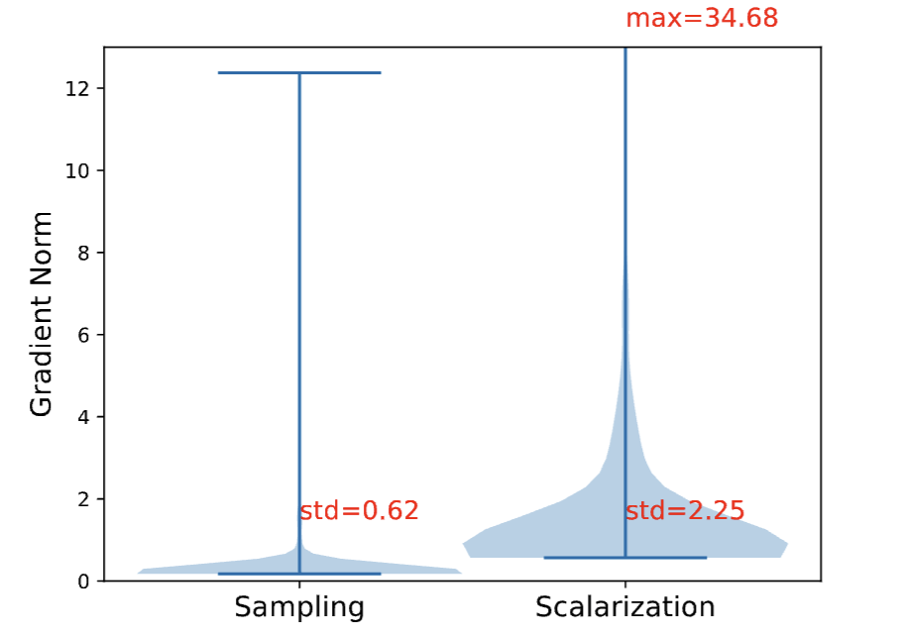
TS vs S gradients: empirical evidence
Notes:
Here we see Gradient Norm distributions on for for Temperature sampling and Scalarization.
Results show that Scalarization induces a larger variance between mini-batch gradients compared to Temperature Sampling.

Slide 54
Summary thus far
Training on imbalanced data:
Scalarization: weighting domains
Temperature Sampling: resampling from domains
Despite the common perception, these two are not equivalent.
TS offers gradients estimates with lower variance.
Next: how is this useful for model training?

Slide 55
TS vs S: How do they affect my optimization?
It is well-known that variance-reduction accelerates the convergences of SGD (Sutskever et al., 2013; Kingma and Ba, 2015)
TS provides lower variance gradient estimates than S.
Hypothesis. Temperature Sampling (at higher temperature) converges [much] faster than Scalarization on heavily imbalanced domain distributions.
Notes:
…
We thus hypothecize that: …

Slide 56
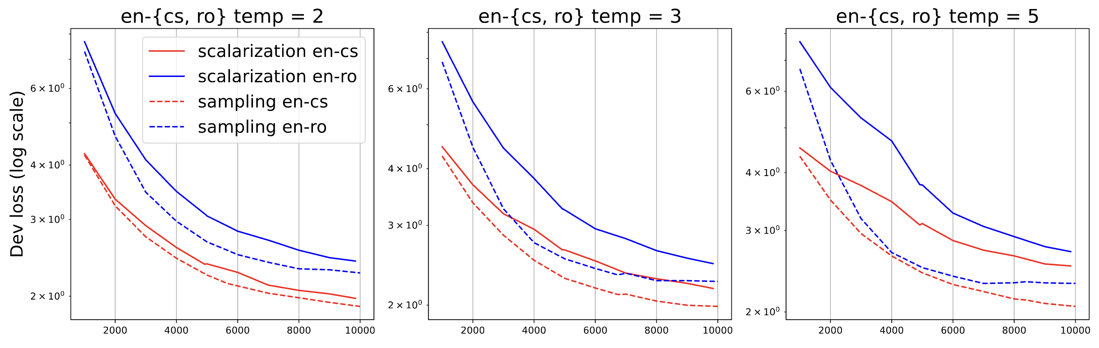
Temperature Sampling’s faster convergence
We train an MT model for pair of high and low-resource languages.
Temperature Sampling converges faster than Scalarization.
Notes:
We train a multilingual machine translation model on pair of languages, one high-resource language (Czech) with a low-resource language (Romainian)

Slide 57
Temperature Sampling’s faster convergence
We train an MT model for pair of high and low-resource languages.
Large Temperature Sampling is prone to overfitting
Larger temperature --> faster convergence for Temperature Sampling (dashed)
Notes:
We repeat this exercise for and vary the sampling temperature τ = {2, 3, 5}.

Slide 58
Summary thus far
Temperature Sampling converges faster than Scalarization.
If temperature is set too high, this faster convergence might lead to overfitting.
Next: how is this useful for training on imbalanced data?

Slide 59
Training on a collection of “domains”
English
Swahili
Tokens of pretraining data by language in mC4 (Xue+ 2024)
Italian
Chinese

Slide 60
How should we [pre-]train on imbalanced data?
We need to strike a good balance between
High-temperature (faster convergence)
Low-temperature (avoid overfitting)
❄️ COOLDOWN ❄️
Train with Temperature Sampling
Start with a high-temperature
Over the course of training

Slide 61
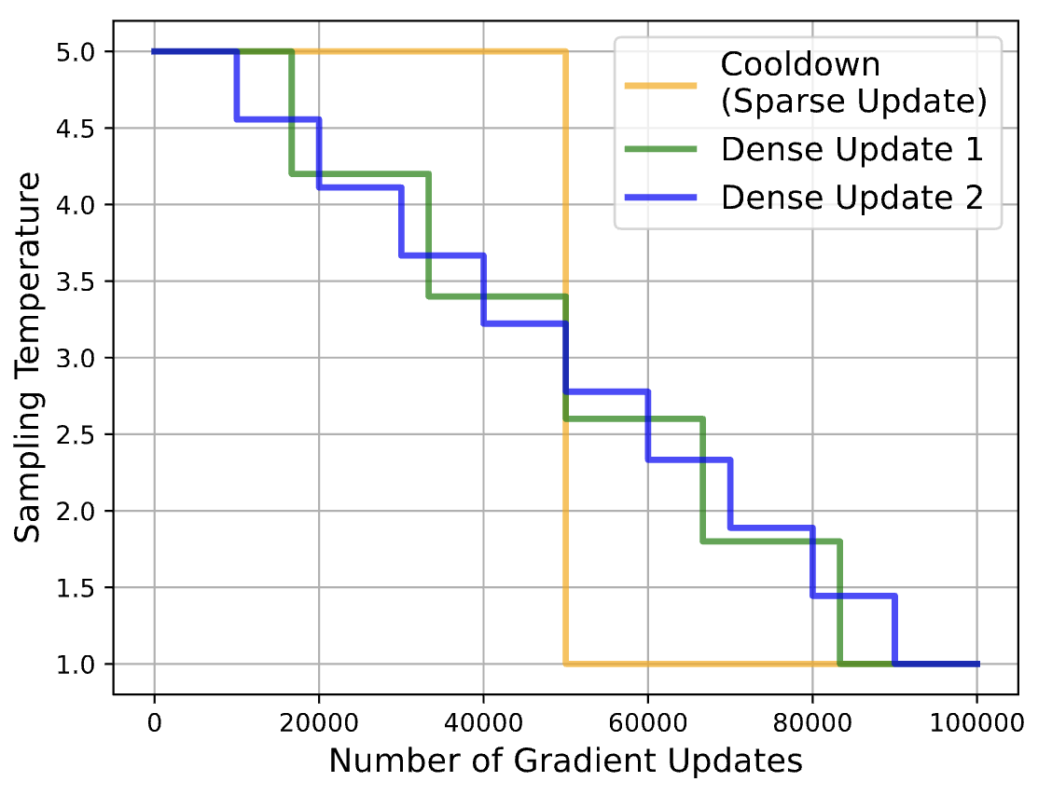
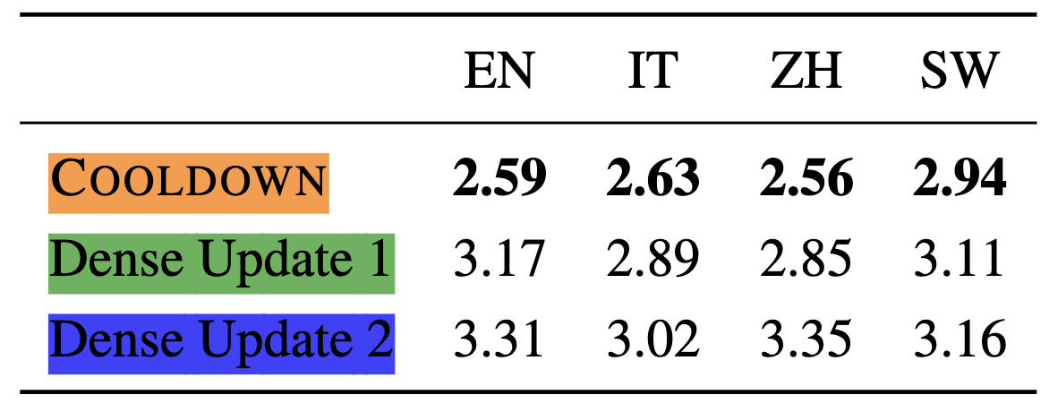
How fast/smoothly should we CoolDown?

Slide 62
Multilingual Language Modeling
Dev Loss on mC4
CoolDown performs better than fixed-temperature (high or low) sampling.
Notes:
We also experimented with the general language modeling
task on multiple languages on selected languages
on the multilingual C4 (mC4) dataset.
We report the validation loss.

Slide 63
Multilingual Language Modeling
Upsamples LRLs at the beginning of training and removes them later
Upsamples LRLs at the end of training
Dev Loss on mC4
CoolDown performs better than fixed-temperature (high or low) sampling.
Notes:
Again, we see that CoolDown achieves the best overall performance.

Slide 64
Summary
Two common approaches for dealing with imbalanced data:
Temperature sampling
Scalarization
Despite common perception, these two are not equivalent.
Temperature sampling leads to lower-variance grad estimates
... and faster convergence.
❄️ COOLDOWN ❄️
A suggested recipe for imbalanced [pre-]training

Slide 65
Overall conclusions
Stale data
Effective cutoffs of LLMs are years earlier than reported cutoff.
Old data are not removed by deduplication pipelines.
Open problem: how should we strike a balance between data coverage and recency?
Imbalanced data
Resampling is a competitive strategy—better than weighting.
An effective resampling (in quality and speed) requires adaptively adjusting the sampling distribution (temperature).
Notes:
Where we, I think, is that:
…
Specifically, today I am going to discuss two topics on reliability of models.

Slide 66
Data! Data! Data! … I can’t make bricks without clay! . ---Sherlock Holmes
Understanding data (and how to use it effectively) is difficult but necessary for our progress.

Slide 67













Thanks for wonderful collaborators on these projects:
Funding:
Notes:
And finally, I’ll end with a shout out to my collaborators that made all these works possible!
- Orion
- Tianjian
- lingfeng

